Slide 1
Tackling Health Inequalities
Course J4M328
Claire Somerville, PhD.
Medical Anthropologist

Slide 2
The essence
“Of all the forms of inequality, injustice in health is the most shocking and inhuman.”
Martin Luther King Jr
“Health inequalities can be defined as avoidable and unjust differences in the health status attributable to the social determinants of health which are the conditions in which people are born, live and work”
SDOH, Commission 2008

Slide 3
Who are we all?
Background – studies, home?
What motivates you?
Why Global Health?
Why this course?
Future career ideas?
Hobby? Interest? Passion?
Toothbrush colour?

Slide 4
The course
Course Description This interdisciplinary course examines the social, political, commercial and economic determinants of health as a lens on the structural and systemic factors that produce health inequalities.
Foregrounding an intersectionality approach to the multiple and intersecting drivers of health inequalities, the course will provoke students to think through innovative policies, practices and interventions that seek to address root causes ranging from global and geopolitical poverty, resource distribution, health system access and the challenges of Universal Health access (UHC) to structural discriminations associated with, for example, race, class, gender, sexuality, ableism, religion, migration and citizenship, indigeneity and colonialism.

Slide 5
Learning Modules
The course is structured in three parts each with a specific learning objective:
1. Part I Foundations to Understanding and Tackling Global Health Inequalities
2. Part II Understanding Axes of Health Inequalities
3. Part III Emergent issues in health inequality

Slide 6
Learning Outcomes
Part I Foundations to Understanding and Tackling Global Health Inequalities
Learning Outcome:
Gain a theoretical and conceptual overview of approaches to health inequalities and inequities within and between countries
Part II Understanding Axes of Health Inequalities
Learning Outcome:
Develop knowledge and an in-depth understanding of the intersecting axes of health inequality and inequities
Part III Emergent issues in health inequality
Learning Outcome:
Critically engage with emergent issues and debates on equality and equity in global health policy and practice

Slide 7
The structure: part I
Foundations to Understanding and Tackling Global Health Inequalities
Core concepts
Underlying drivers – poverty to resources
Within and between countries
Social determinants approach- frameworks

Slide 8
Structure: Part II
Understanding Intersecting Axes of Health Inequalities
Socio-political-cultural-commercial determinants
Intersectionality gaze
Dynamics of power
Units of analysis to understand inequalities in health
Gender, Race &Ethnicityy, Place, Education, Work andLivelihood, Migration and Movement of People,

Slide 9
Structure Part III
Emergent Issues
New geopolitical faultlines
Role of trade and tech transfer
How will health tech impact health inequalities
What are the links andfuturee of health in world of climate change

Slide 10
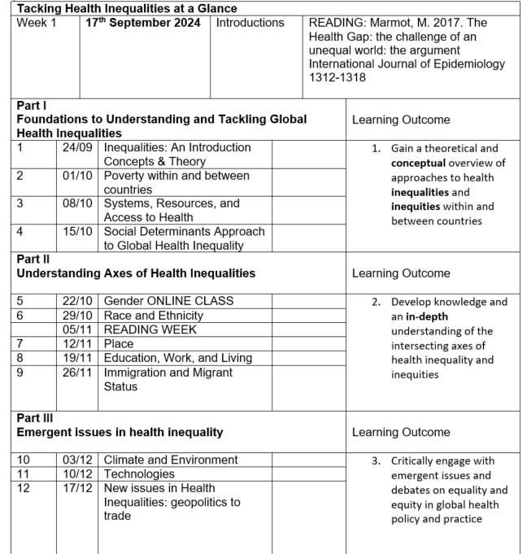

Slide 11
Introductions | 17^{h} Sept | Introduction
PART I FOUNDATIONS TO UNDERSTANDING AND TACKLING HEALTH INEQUALITIES
Seminar 1 24th Sept | An Introduction to Concepts and Theory of Inequality, Equity and Justice
Seminar 2 1st Oct | Poverty within and Between Countries and Health Inequalities |  | Student Case Studies
Seminar 3 8th Oct | Systems, Resources and Access to Health |  | Student Case Studies
Seminar 4 15^{h} Oct | Social Determinants Approach to Health
PART II UNDERSTANDING AXES OF HEALTH INEQUALITIES
Seminar5 22nd Oct | Gender (ONLINE CLASS)
Seminar 6 29 Oct | Race and Ethnicity |  | Student Case Studies
5th Nov READING WEEK
Seminar 7 12th Nov | Place |  | Student Case Studies
Seminar 8 19th Nov | Education, Work and Living |  | Student Case Studies
Seminar 9 26th Nov | Immigration, Migration and Movement of People |  | Student Case Studies
PART III EMERGENT ISSUES IN HEALTH INEQUALITY
Seminar 10 3rd Dec | Climate and Environment |  | Student Case Studies
Seminar 11 10th Dec | Technologies |  | Student Case Studies
Seminar 12 17th Dec | New issues: Geopolitics to Trade

Slide 12
Assessment
Students are evaluated on the following requirements:
1. 50% Final written assignment of 2000 words A policy brief/case study in response to a global health inequality/inequity challenge of choice submitted by midnight 20th December 2024
2. 50% Class participation/case study presentations x 2
Each student will co-host two seminars in this format which together carry 50% of total grade (i.e. 25% for each seminar case study)
Eight sessions are open to student-led case studies in pairs (or 3s) according to number of students.

Slide 13
The readings
Diverse
Short to long
Text book to viewpoints
Generic Health Inequalities core texts
Select at least two per week and come prepared to discuss them

Slide 14
Core Texts
Marmot M and Wilkinson R (eds) (2005). Social Determinants of Health. 2nd edition. Oxford:
Green, T. (2021). The Covid Consensus: The new politics of Global Inequality. Hurst. Book
Marmot, M. (2005). Status syndrome: how social standing affects our health and longevity.
Marmot, M (2015). The Health Gap: The challenge of an unequal world. Bloomsbury
Walraven, Gijsbertus Engelinus Laurentius. Health and Poverty : Global Health Problems and
Solutions. London: Earthscan, 2011
Bambra, C., Lynuch, J., Smith, K. (2021) An Unequal Pandemic: Covid 19 and health Inequalities. Policy press
Bartley, M. (2016). Health inequality: an introduction to concepts, theories and methods.
Graham H (2007). Unequal Lives: Health and socioeconomic inequalities. Maidenhead; Open University Press.
Graham H (ed) (2009). Understanding Health Inequalities (2nd ed). Maidenhead; Open
Dudrys, G. (2017). Unequal Health: How inequality contributes to health and Illness. University Press.
Buchbinder, M., Rivkin-Fish,M., Walker, R. (Eds.) Understanding health Inequalities and Justice: New conversations across the disciplines. University of North Carolina
Hofrichter, R., & Bhatia, R. (2010). Tackling health inequities through public health practice Theory to action. Oxford University Press, Incorporated.

Slide 15
Next week – a plan!
Arrive with definitions of equity, equality, inequity and inequality
Note the source of definition (e.g. Government MoH; IO; WHO; INGO, UN, Resolution/Treaty, Faith-based organiationsetc.)
Note context of definition (e.g. Mission statement; Policy; Resolution; Directive; Vision; Approach etc.)
Note them down and come prepared to share them in class

Slide 16
If we have time -------
Covid and Inequalities in Health – what can we learn?
In pairs for 10 mins:
What did the pandemic tell us about the relationship between health outcomes and inequalities?
Inequalities of health or inequalities of other factors?
Whose bodies mattered during the pandemic?
What were the major controversies during covid and how has the world responded?
What have we learned about global health inequity during covid?

